Slide 1
Natural Language Processing:
Past, Present, and Future
Dr. Chris Irwin Davis

Slide 2
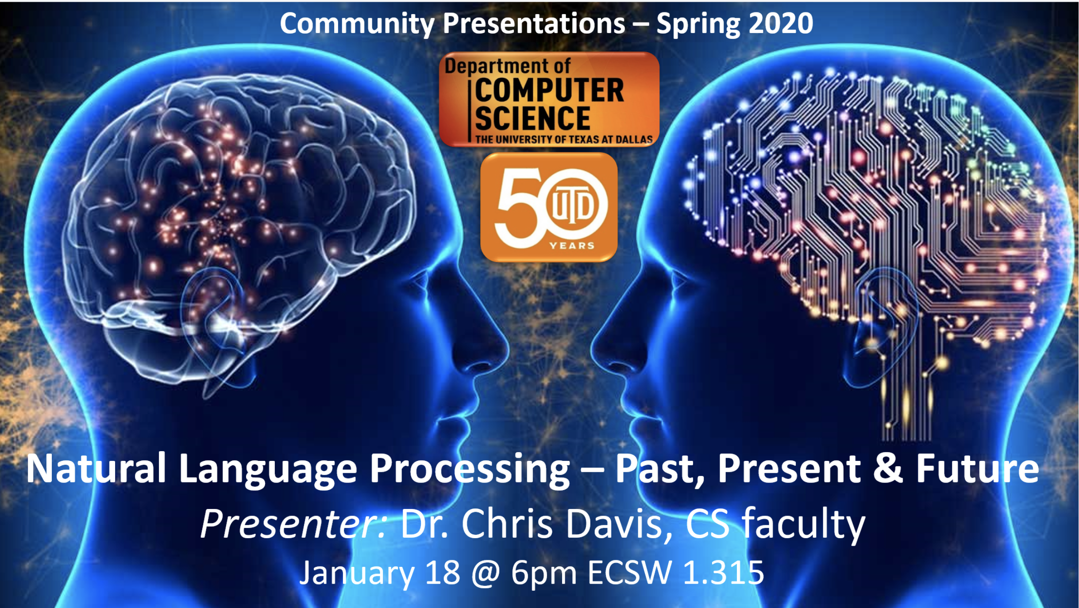

Slide 3
Natural Language Processing:
Past, Present, and Future
Notes:
I’ll spend most of the time on the present
Then we’ll look at some actual code with a Python Library

Slide 4
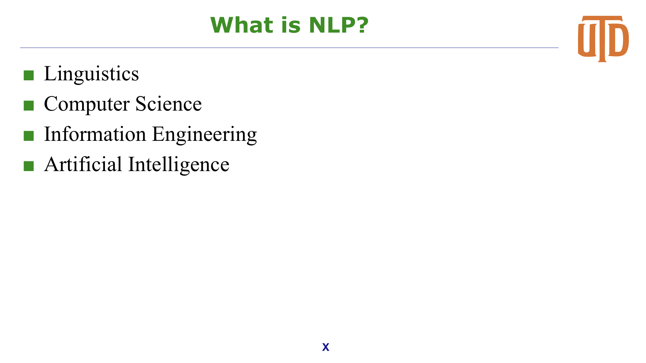
What is NLP?
Linguistics
Computer Science
Information Engineering
Artificial Intelligence
Machine Learning

Slide 5
What is NLP?
Natural language parsing
Text parsing
Speech recognition
Natural language generation
Natural language understanding (NLU)

Slide 6
Why is it a hard problem?
Machine Translation
Grammar differences
Non one-to-one word mapping
Natural Language Understanding
Ambiguous grammars
Semantic search
Context
Real world knowledge

Slide 7
PAST

Slide 8
Formal Languages
What is a Language?
A set of strings
What is a “set”?
What are “strings”?

Slide 9
Formal Languages
In mathematics, computer science, and linguistics, a formal language consists of words whose letters are taken from an alphabet and are well-formed according to a specific set of rules.
The set of rules is called grammar

Slide 10
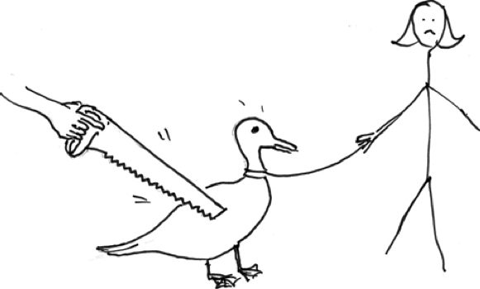
What is the difference?
Natural Languages vs Programming Languages
Statements
int x = 500;
0x000001F4
“I saw her duck”

Slide 11
Overlap with AI
Agency and Autonomy vs Algorithms and Heuristics
Sentience
Sapience
Consciousness
Self-awareness

Slide 12
NLP Approaches
Rule-based
Statistical
Corpus based
Example based
Logic based

Slide 13
The Two Pillars of NLP
Syntax
Structure (grammar)
Semantics
Meaning

Slide 14
Historical (IBM-Georgetown)
IBM-Georgetown
Georgetown University (1954)
Completely automatic translation of more than sixty Russian sentences into English
Used “Romanized” Russian (transliteration)
Vyelyichyina ugla opryedyelyayetsya otnoshyenyiyem dlyini dugi k radyiusu.
Magnitude of angle is determined by the relation of length of arc to radius.
Rule-based and hard-coded
Notes:
https://en.wikipedia.org/wiki/Georgetown–IBM_experiment

Slide 15
Historical (SHRDLU)
SRDLU
Natural language understanding (NLU)
MIT (1968-70)
Linotype keyboard layout (ETAOIN SHRDLU) Descending order of usage frequency in English
<100 word vocabulary
Created a model of Block World
Blocks, colors, relative location
Notes:
https://en.wikipedia.org/wiki/SHRDLU
Name comes from keyboard layout of Linotype machine
ETAOIN SHRDLU
Eliza
IBM Machine Transation

Slide 16
Historical (Eliza)
ELIZA
MIT (1964-66)
Natural language understanding (NLU)
Based on the “DOCTOR” script
One of the first chatbots and one of the first programs capable of attempting the Turing test
Many early users were convinced of ELIZA’s intelligence and understanding

Slide 17
Historical (ELIZA)

Slide 18
Historical (PARRY)
PARRY
Stanford (1972)
Natural language understanding (NLU)
A chatbot that attempted to simulate a person with paranoid schizophrenia
It was described as “ELIZA with attitude”
Connected with ELIZA via ARPANET

Slide 19
Syntax
Universal Grammar
Became a focus of Machine Translation
Interlingua-based MT
Notes:
In 1957, Noam Chomsky’s Syntactic Structures revolutionized Linguistics with 'universal grammar', a rule based system of syntactic structures.[1]

Slide 20
Semantics
“Colorless green ideas dream furiously.”

Slide 21
Philosophical Perspectives
Alan Turing’s Imitation Game
John Searle’s Chinese Room

Slide 22
PRESENT

Slide 23
Tasks
Language models
n-grams
Machine Translation
Syntax
Treebank
Computational Semantics
Semantic search (semantic similarity)
Classification
document
Deep learning

Slide 24
Computer Science 101
Language
Unordered collection (set) of strings
Strings
Ordered Sequence of characters
Arrays, Lists
Characters

Slide 25
Character Encoding
ASCII (1 byte)
Extended ASCII (1 byte)
UCS (2 bytes)
Unicode (4 bytes)
UTF-8 (1-4 bytes)

Slide 26
Programming Representation
Text
Strings
Syntax
Trees
Semantics
Graphs

Slide 27
Language Models
What’s a model?
n-grams
Statistical NLP
Frequency of n sequence of lexemes occurring
Language
Corpus
Domain
Notes:
Using a domain-specific corpus introduces semantics (knowledge) by leveraging human knowledge
Baseball – diamond, base, field, home, bat, ball, clubhouse

Slide 28
Machine Translation
Statistical (SMT)
Phrase-based
Rule-based (RBMT)
Hybrid MT
Neural MT
Deep Learning

Slide 29
Semantics
Inferred semantics (via domain-specific corpus)
Inferred semantics via co-location
diamond
diamond + batter
diamond + setting
diamond + rhombus
diamond + carbon

Slide 30
Synonym Sets (synsets)
Mapping of lexemes to semantics
Lexical semantics
Language specific

Slide 31
FUTURE

Slide 32
Real-time machine learning
Already doing this with orthography and syntactical features (language modeling)
Next generation deep learning
NLU
Strong AI

Slide 33
ADDITIONAL
RESOURCES

Slide 34
Tools
Libraries
Python NLTK
Stanford NLP Library Java
Tools
WordNet (lexical semantic database created at Princeton)
eXtended WordNet (created at UTD)
Treebank (database of syntax trees created at UPenn)
VerbNet
FrameNet

Slide 35
Tools (cont’d)
POS Taggers
MXPOST
Tree Tagger
LingPipe

Slide 36
Corpora
Mono-linguistic (English)
Brown Corpus (1M words)
British News Corpus (100M words)
TIME Magazine Corpus (100M words)
Gigaword (1B words)
Notes:
Brown University Standard Corpus of Present-Day American English (aka Brown Corpus)
https://en.wikipedia.org/wiki/Brown_Corpus
The corpus consists of one million words of American English texts printed in 1961. The canonical metadata on NLTK:
https://www.english-corpora.org/bnc/
100M words
https://www.english-corpora.org
https://catalogue.elra.info/en-us/repository/browse/ELRA-W0020/
Hamshari, Persian
https://en.wikipedia.org/wiki/List_of_text_corpora

Slide 37
Corpora
Mono-linguistic
PAROLE (French, 3.2M words)
German Reference Corpus (4B words)
DysListGerman
Corpus of German mistakes from people with dyslexia
Russian National Corpus (600M words)
Bijankhan (Farsi, 2.6M words)
Kayhan (Farsi, 0.8M words)
Notes:
Free corpus of German mistakes from people with dyslexia
https://rauschii.github.io/DysListGerman/
https://catalogue.elra.info/en-us/repository/browse/ELRA-W0020/
Hamshari, Persian

Slide 38
Corpora
Multi-lingual
OPUS (Over 60 languages)
Europarl (EU Languages - EU parliament procedings)
MULTEXT-East (Mulitple East European Languages)
Hansards (French-English)
Notes:
Brown University Standard Corpus of Present-Day American English (aka Brown Corpus)
https://en.wikipedia.org/wiki/Brown_Corpus
The corpus consists of one million words of American English texts printed in 1961. The canonical metadata on NLTK:

Slide 39
NLTK
n-grams
Language models
Parse trees

